Slide 1
Data Acquisition Prototype:
Project & System Requirements
Phoenix
Ambulatory Blood Pressure Monitoring System
© 2008 Christopher J. Adams
Copying and distribution of this document is permitted in any medium, provided this notice is preserved

Slide 2
Agenda
Project Vision
System Vision & Scope (Business Requirements)
User Requirements
  Use Cases
  Business Rules (Algorithms)
System Requirements
  Functional Requirements
  Major Nonfunctional Requirements
Requirements Work Outstanding

Slide 3
Project Vision
Acquire community knowledge about
  Data acquisition devices
  Hardware and software co-design
  Partitioning systems into subsystems
  Allocating system requirements to subsystems
  Embedded software architecture options
  (round robin, round robin w/ interrupts, …, RTOS)
  Hardware options
  (MP, memory, gates, buses, ports, clocks, …)
  Acquiring hardware components
  Testing embedded software

Slide 4
Project Vision
Architecture — basic technology
  Hardware architecture
  Hardware component selection
  Embedded software architecture
  Software language selection
  Cross-platform development tools
Prototype
  Learning is primary
  Willing to abandon device based on lessons learned
Acquired data may be simulated

Slide 5
System Vision
Data acquisition device
  Collects analog signals from (which sensor?)
  Converts analog signals to digital signals
Embedded analytics
  Calculates [BP | Heart Rate | easiest measurement to calculate]
Embedded data storage
  Timestamps each acquired & calculated value
  Preserves acquired values beat-to-beat
  Preserves calculated values (how often?)
  Preserves up to (how many hours/days?) of data
Device allows ambulation during use
  At least carriable

Slide 6
System Vision
Major Out-of-Scope Capabilities
Capacity for 7 days of data
Device calibration
Patient alerts
Wearer events

Slide 7
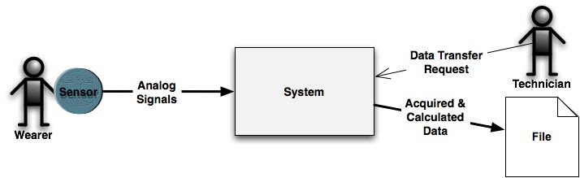
System Context

Slide 8
Use Cases
Technician connects device to Wearer
Wearer starts data collection
Wearer confirms device is working
Technician downloads data to a file

Slide 9
Business Rules
Algorithms
BP | Heart Rate?

Slide 10
Major Nonfunctional Requirements
Interfaces
  Outgoing
    Downloaded data is well-formed XML
  Physical Connectors
    Device downloads data via a USB device
Physical Constraints
  Wearer wears or carries device during operation

